Slide 1
Decodable Books
Aim:
To provide top tips for:
choosing decodable books that match your phonics scheme.
checking that the books you do already have are fit for purpose.

Slide 2
Reflect/Discuss
How are your “early reading books” currently organised?

Slide 3
Read aloud, accurately, books that are consistent with their developing phonic knowledge, that do not require them to use other strategies to work out words [and] re-read these books to build up their fluency and confidence in word reading.
National Curriculum
How do we do this?

Slide 4
What is book banding?
(Read Blog by Ruth Miskin)

Slide 5
What do we mean by a ‘decodable’ book?
Notes:
A book that matches our phonic knowledge.
We can decode all of the words.

Slide 6
OFSTED Handbook
the sequence of reading books shows a cumulative progression in phonics knowledge that is matched closely to the school’s phonics programme. Teachers give pupils sufficient practice in reading and re-reading books that match the grapheme-phoneme correspondences they know, both at school and at home

Slide 7
Ofsted’s on the ball
In the early stages of learning to read, pupils are reading books which closely match their phonic knowledge. This is helping them to become accurate and fluent in their reading.
Ofsted report in West Yorkshire, April 2019

Slide 8
Ofsted’s on the ball
In the primary phase, pupils achieve well in all subjects. Teaching helps pupils to develop a love of reading. They are enthused by story-time sessions. Books are well matched to pupils’ ability.
Ofsted Report in Northampton January 2020

Slide 9
What is meant by “reading books that closely match their phonic knowledge”?

Slide 10
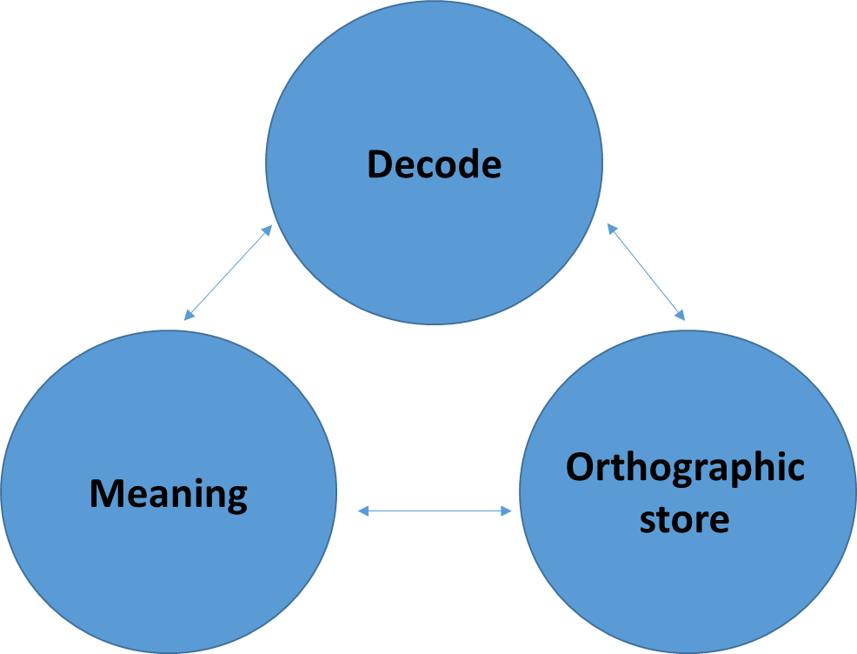
Find children’s Goldilocks spot
Use the SSP assessment to match the books the children read to the sounds they know.
Consider the
meaning

Slide 11
Re-organising early reading books
Audit current books
Purchase new books
Organise and label clearly
Agree new systems with teachers
Inform Parents

Slide 12
Informing Parents Practice of reading decodables at home
Purpose of a decodable book /”sharing” book
How to sound out words
How to read common exception words
Importance of re-reading the story to develop fluency
How to chat about the story with their child
Listen to their child read every day
Make it an enjoyable experience - patience and love.

Slide 13
Practice
How do you ensure that all children
are able to practise their
“home” decodable book?

Slide 14
English Hub Challenge Checklist

Slide 15
Any questions?

